Slide 1
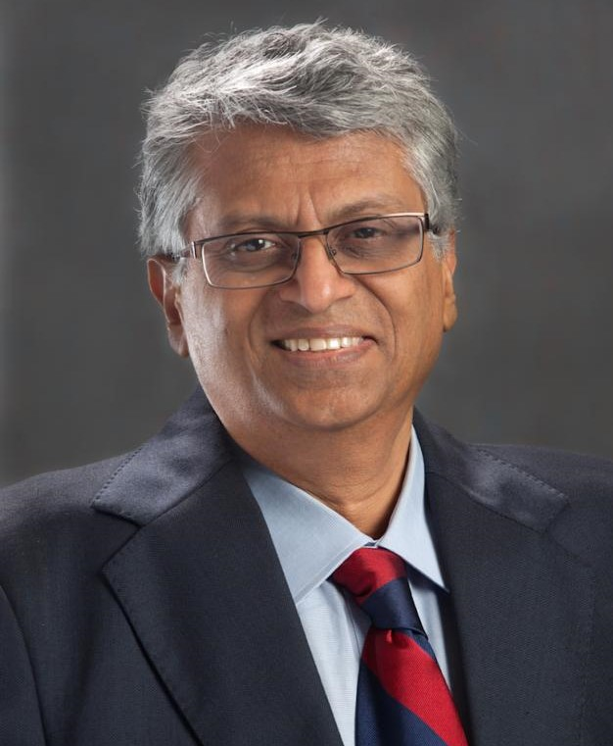
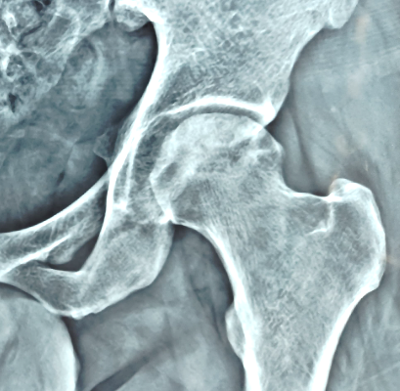
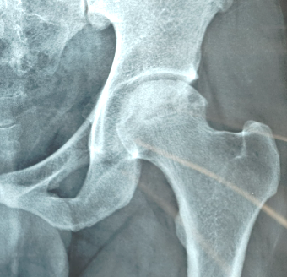

RESOLUTION OF AVASCULAR NECROSIS OF THE HIP WITH INNOVATIVE MEDICAL TREATMENT AVOID HIP REPLACEMENT, DECOMPRESSION, DRILLING
After 3 years
of therapy
DR. SANJAY AGARWALA
D.ORTH, M.S. ORTH(BOM), MCH. ORTH (ENGLAND)
Director Professional Services
Consultant, Joint Replacement & Orthopaedic Reconstructive Surgery at
P.D. Hinduja Hospital & Breach Candy Hospital, Mumbai.
Clinic at : 104B, Sukh Sagar, Opera House, Mumbai 400 007

Slide 2
CELEBRITY PICS A LITTLE BRIGHTER

Slide 3
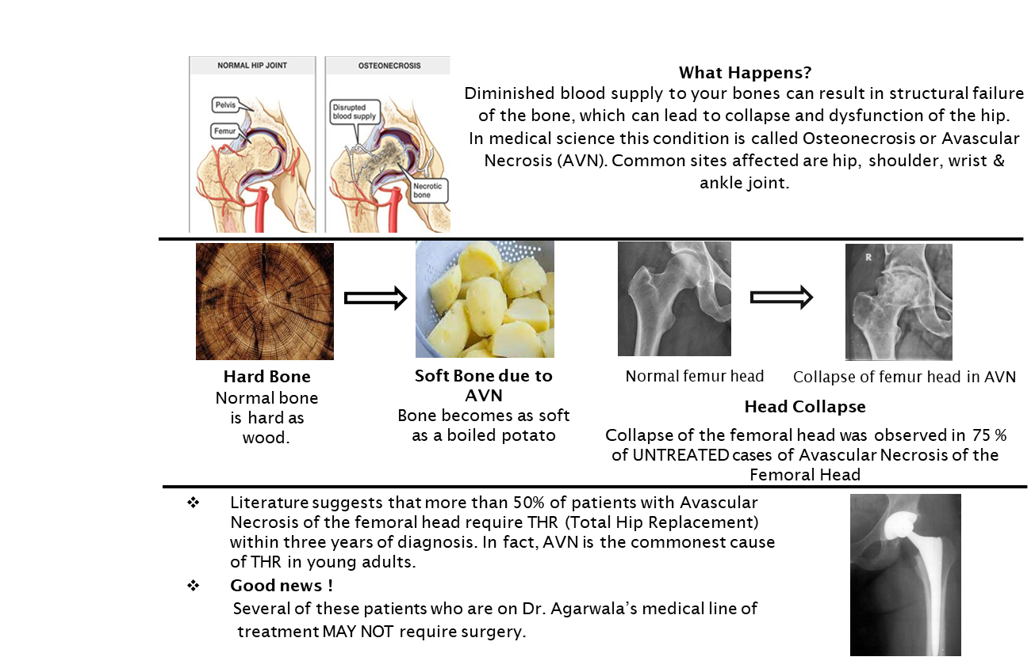

Slide 4
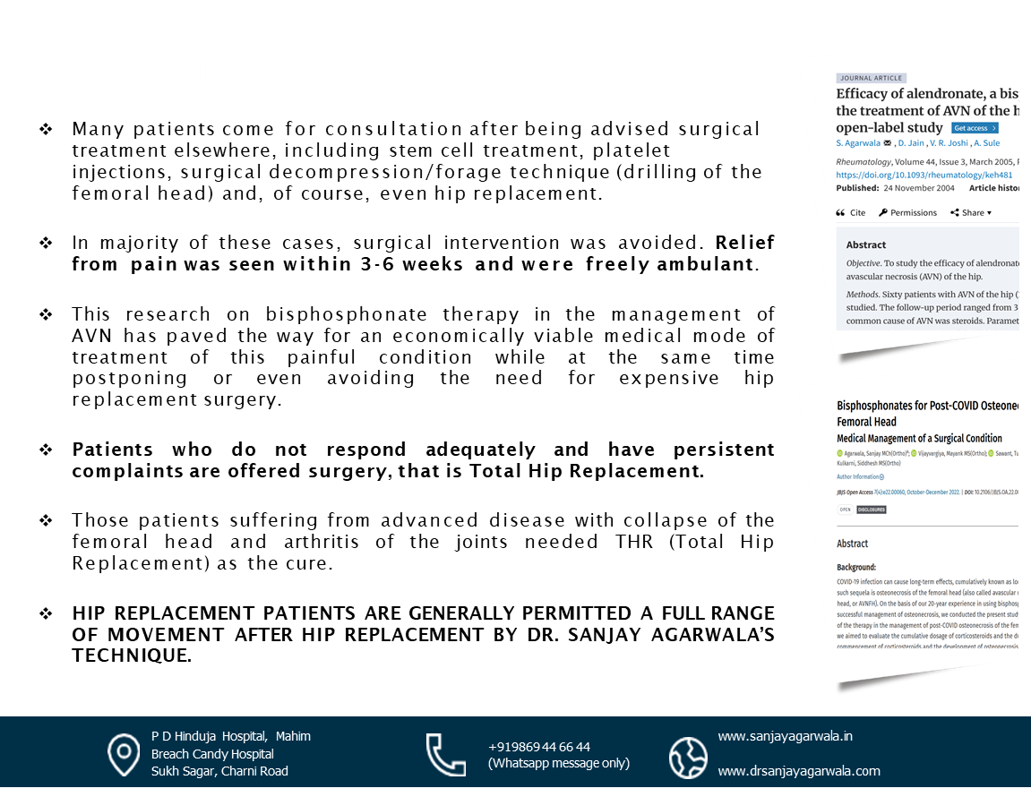
SOME TRUTHS
Many patients come for consultation after being advised surgical treatment elsewhere, including stem cell treatment, platelet injections, surgical decompression/forage technique (drilling of the femoral head) and, of course, even hip replacement.
In majority of these cases, surgical intervention was avoided. Relief from pain was seen within 3-6 weeks and were freely ambulant.
This research on bisphosphonate therapy in the management of AVN has paved the way for an economically viable medical mode of treatment of this painful condition. The treatment can postpone/avoid the need for expensive hip replacement surgery.
Patients who do not respond adequately and have persistent complaints are offered surgery, that is Total Hip Replacement.
Those patients suffering from advanced disease with collapse of the femoral head and arthritis of the joints needed THR (Total Hip Replacement) as the cure.
HIP REPLACEMENT PATIENTS ARE GENERALLY PERMITTED A FULL RANGE OF MOVEMENT AFTER HIP REPLACEMENT BY DR. SANJAY AGARWALA'S TECHNIQUE.

Slide 5

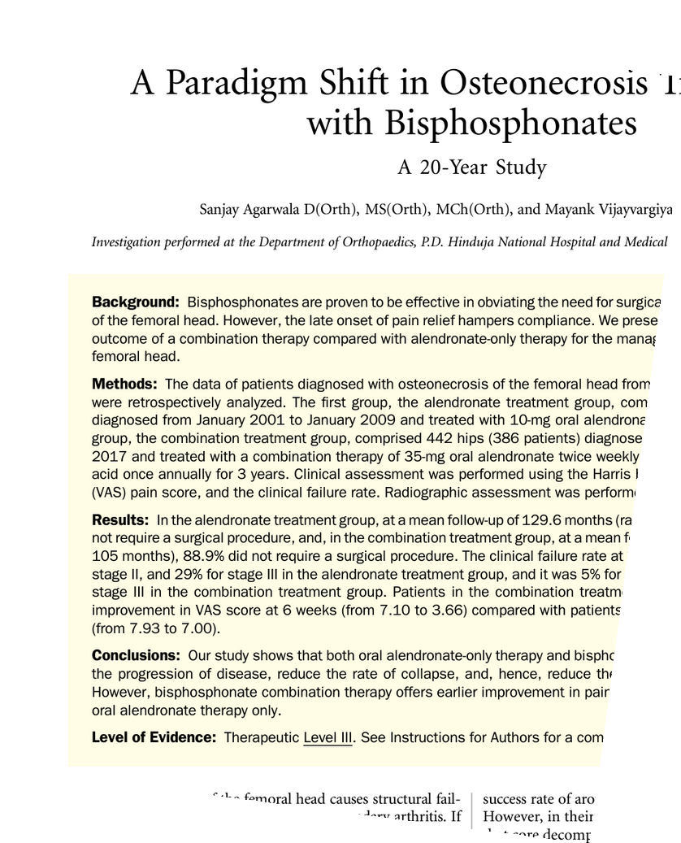

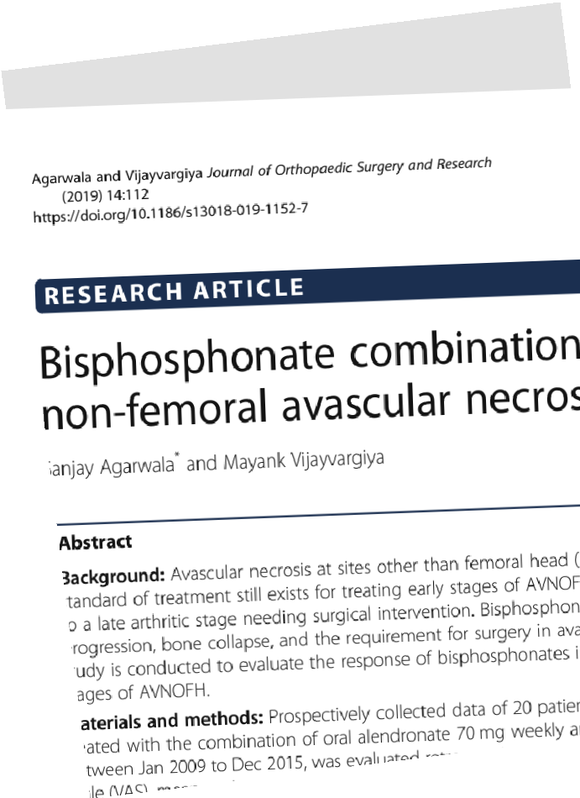

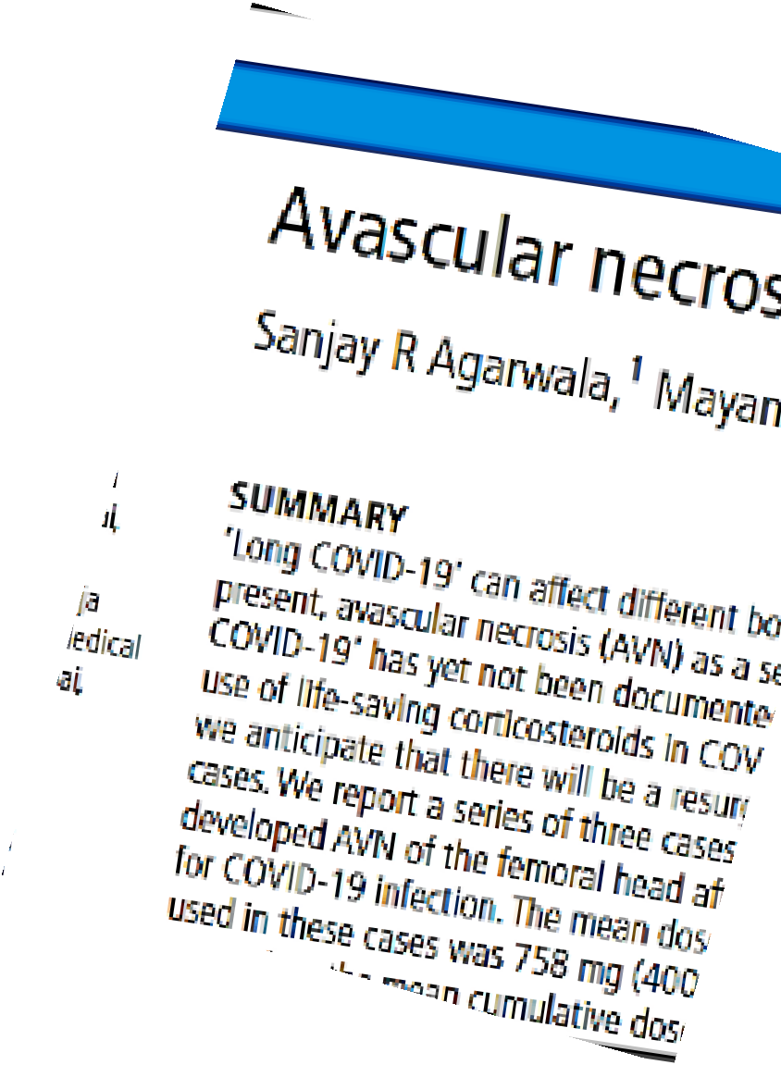
Internationally Published Facts
This is the result of over two decades of dedicated research and practice in medical management of AVN by Dr. Sanjay Agarwala. This expertise offers hope for patients with AVN of the hip.
Dr. Sanjay Agarwala has proposed using bisphosphonates as a repurposed treatment for AVN, since his first publication in the year 2001.
This approach has proved highly effective in managing this painful & debilitating condition for over 25 years and has been published in 15 international peer-reviewed journals.
This treatment needs to be continued for at least three years in view of the three-year natural course history of AVN and the established three-year safety profile of bisphosphonate use.
The published studies done by Dr. Sanjay Agarwala have shown 98% success rate in Stage I, 92% success rate in stage II and 70% success rate in stage III, which is far better than the various studies done in the past which have a success rate of only around 30%.
P D Hinduja Hospital, Mahim
Breach Candy Hospital
Sukh Sagar, Charni Road
+919869 44 66 44 (Whatsapp message only)
www.sanjayagarwala.in
www.drsanjayagarwala.com

Slide 6



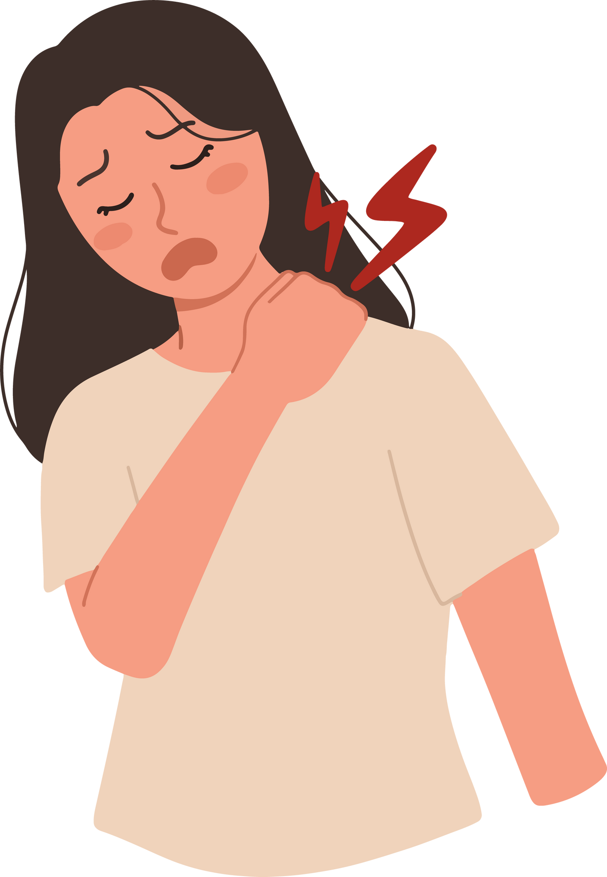
Treatment plan
M A N A G I N G A V N W I T H B I S P H O S P H O N A T ES- A COMPREHENSIVE GUIDE
ALENDRONATE tablet 35mg to be taken twice weekly (e.g. Monday & Thursday).
It is recommended that this tablet is taken in the morning, even before brushing your teeth, on an empty stomach, with two glasses of water (tea, coffee or juice WILL NOT do).
Do not eat or drink for up to half an hour after taking the tablet as it will change the acidity of the stomach and prevent the activity and absorption of the tablet.
At the end of 30 minutes, the medicine will have been absorbed and normal activities may be resumed.
Alendronate is now available as 35mg and 70mg preparation. 35 mg twice a week works better than 70mg weekly in AVN cases.
To ensure immediate and sustained blood levels of bisphosphonates for enhanced efficacy, a primary infusion of 5mg Zoledronic Acid injection is also administered intravenously over 45-60 minutes to supplement the availability of the drug in the blood at the start of the therapy.
After receiving the slow infusion of Zoledronic, patients may experience fever, flu-like symptoms, bone pain, and body aches for a day or two. These reactions are minimized by
Slow infusion
A dose of two tablets of 10 mg Wysolone (Prednisolone) taken immediately prior to the infusion & 2 more tablets taken 30 mins after the infusion.
Symptoms can also be managed with Paracetamol (Crocin 500mg tablets or Combiflam) taken 2-3 times a day for 2 to 3 days.

Slide 7



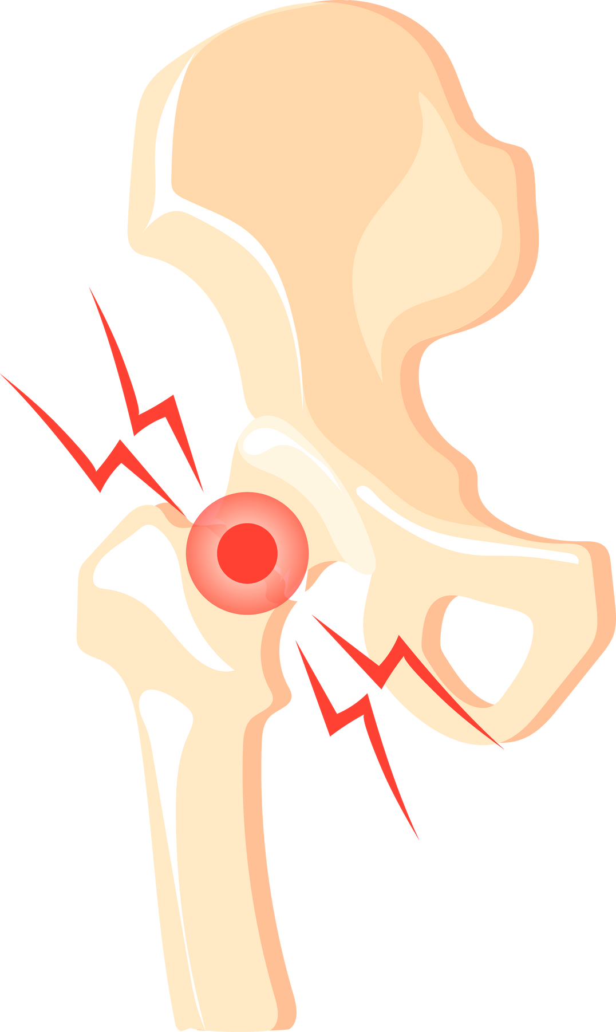
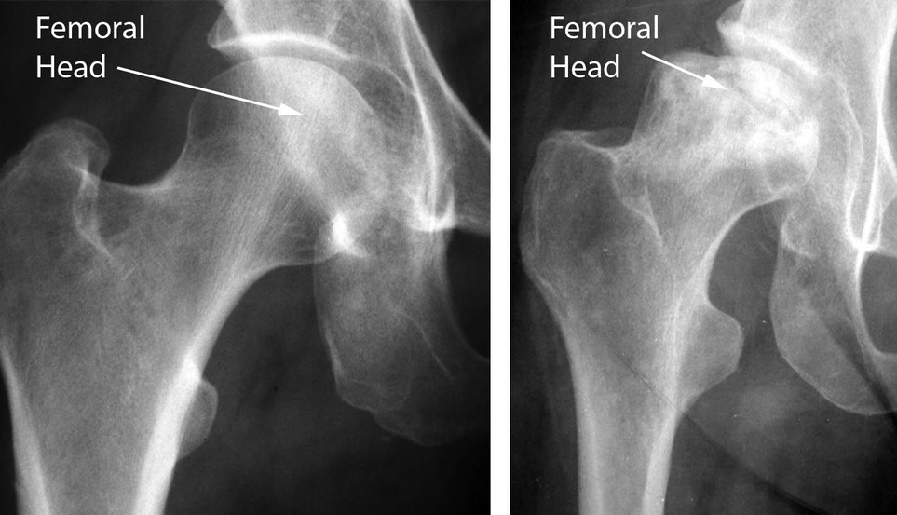
An additional BOOSTER infusion of Zoledronic acid may be advised, to enhance the level of medicine in blood, if the patient does not respond adequately to the standard protocol of bisphosphonate therapy within six weeks.
This helps to potentiate the effects of this medicine.
While on treatment we advise that high impact exercise/physiotherapy be avoided.
These can cause collapse of the soft bone, which would then need surgical intervention like Total Hip Replacement (THR).
Once pain settles Swimming, Walking in a Swimming pool, Yoga and Stationary Cycling could be safe forms of exercise
Collapse of softened bone due to impact
SOFT BONE COLLAPSES WITH EXERCISES.
HENCE, AVOID HIGH IMPACT EXERCISES.
AFTER HIGH IMPACT EXERCISE
BISPHOSPHONATE TREATMENT CONVERTS YOUR SOFT BONE INTO A HARD BONE.

Slide 8


FAQ’S OF BISPHOSPHONATE THERAPY:
Q
Is this therapy safe?
Yes, our research, as published in the Journal of Global Oncology (see references), supports this treatment approach. In 20 years of experience, no major side effects have been faced.
A
Q
What about exercise, physiotherapy and use of walking aids?
While on treatment we advise patients to avoid high impact exercise or rigorous physiotherapy, which can cause collapse of the soft bone. Use walking aids like crutch supports in both arms or a walking stick on the side opposite to the painful side to reduce pressure on the hip.
A
Q
Do I need to take any specific supplements?
It's crucial to take calcium with vitamin D supplements alongside the treatment for the entire three-year duration, as bisphosphonates do not work in absence of vitamin D and calcium
A
Q
Can I swim, do yoga and use stationary cycle?
While on treatment we advise that high impact exercise /physiotherapy be avoided. This can cause collapse of the soft bone. Once the pain is settled, swimming, walking in a swimming pool, yoga and stationary cycling are safe forms of exercise, which will not negatively impact the soft bone.
A

Slide 9
FAQ’S OF BISPHOSPHONATE THERAPY:
Q
When to book follow-up appointments?
Your appointment will be scheduled after 6 to 8 weeks in the outpatient department from the start of treatment, this may be arranged, earlier or later as necessary.
A
Q
Will I need any additional tests or investigations on follow up?
Prior to the follow-up appointment, please arrange to have FRESH/NEW X-Rays of your pelvis with both hips – AP and Frog leg lateral views.
A
Q
What can I expect during follow-up appointments?
After reviewing the new investigations A) if the patient is responding well with more than 70% pain relief, oral bisphosphonate therapy will be continued.
B) If not responding adequately, a supplementary early extra booster dose of Zoledronic acid may be recommended
A
Q
When do you advise for surgery?
We advise surgery for patients who do not respond to bisphosphonate therapy and whose lifestyle, daily activities & quality of life are significantly restricted or hindered by pain.
A

Slide 10
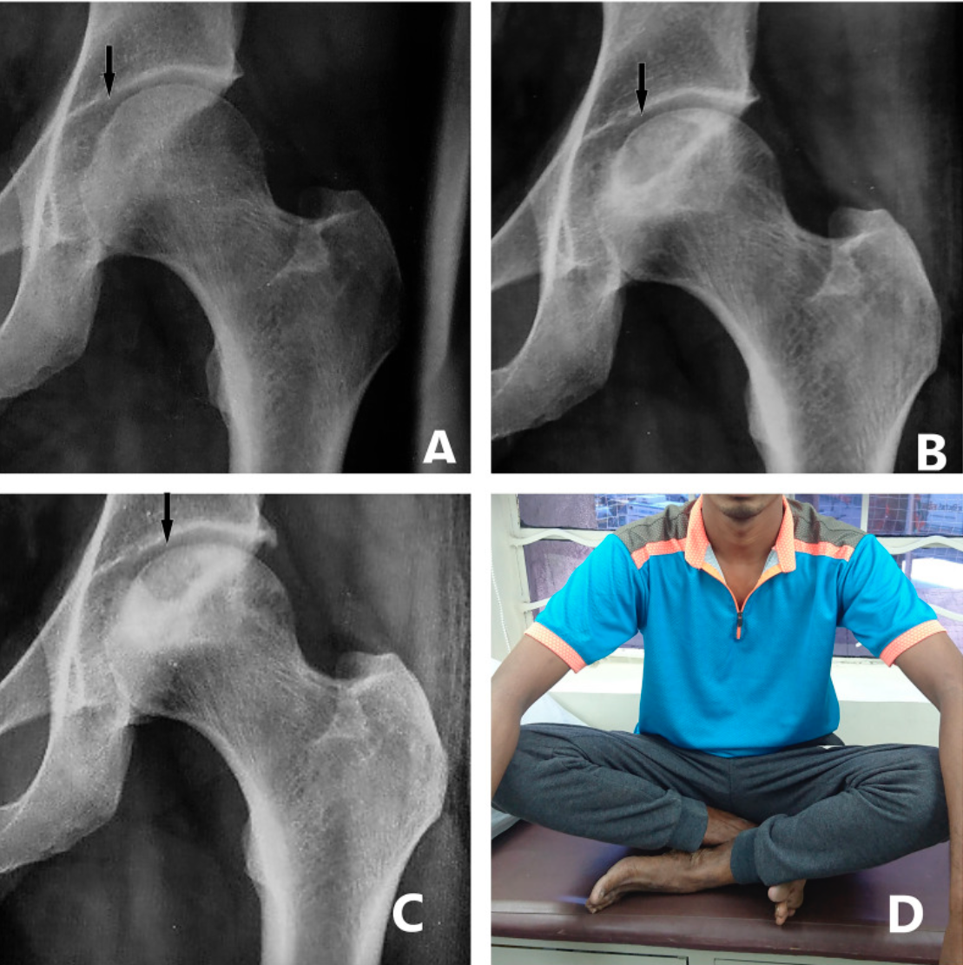
Post treatment results after 3 years
Case 1
1st visit
At 6 months
A: X-ray at the first visit showing signs of osteonecrosis (AVN) in the femoral head.
B: X-ray at 6 months post-treatment demonstrating PARTIAL CONSOLIDATION of the affected bone.
C: X-ray at 3 years showing COMPLETE STRUCTURAL CONSOLIDATION of the femoral head.
D: Patient at the end of 3 years of treatment, exhibiting a FULL RANGE OF MOTION AND NO FUNCTIONAL LIMITATIONS.
At 3 years

Slide 11
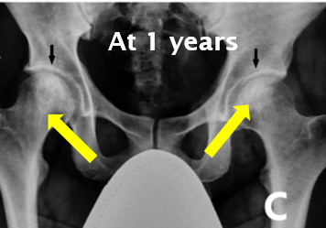
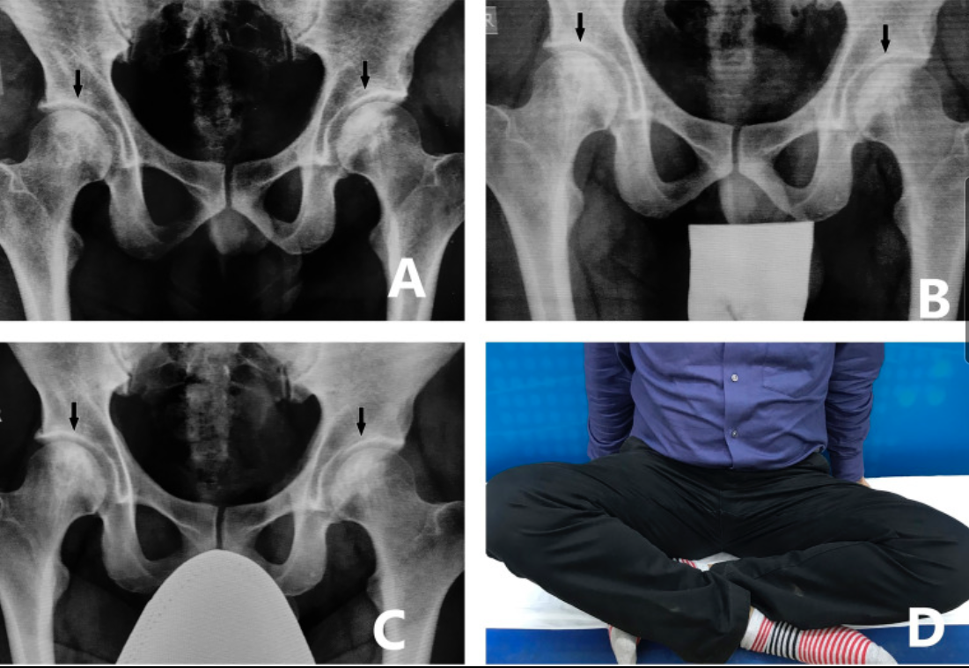
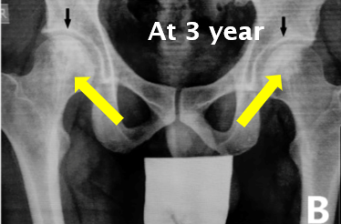
Post treatment results after 3 years
Case 2
A: X-ray at the first visit showing signs of osteonecrosis (AVN) in both the femoral heads.
B: X-ray at 6 months post-treatment demonstrating PARTIAL CONSOLIDATION of the affected bones.
C: X-ray at 3 years showing COMPLETE STRUCTURAL CONSOLIDATION of the femoral head.
D: Patient at the end of 3 years of treatment, exhibiting a FULL RANGE OF MOTION AND NO FUNCTIONAL LIMITATIONS.
1st visit
At 3 year
At 1 years
At 3 years

Slide 12

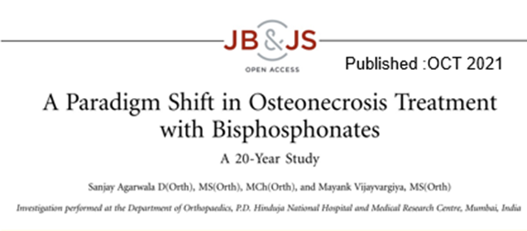
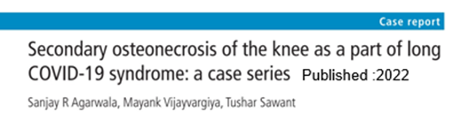
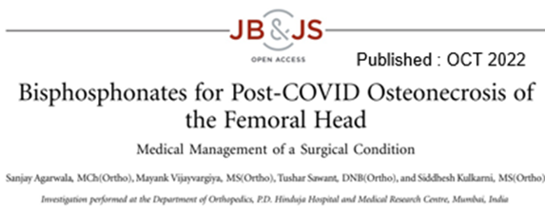

Slide 13
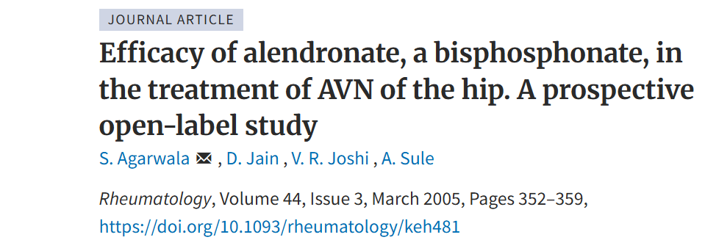


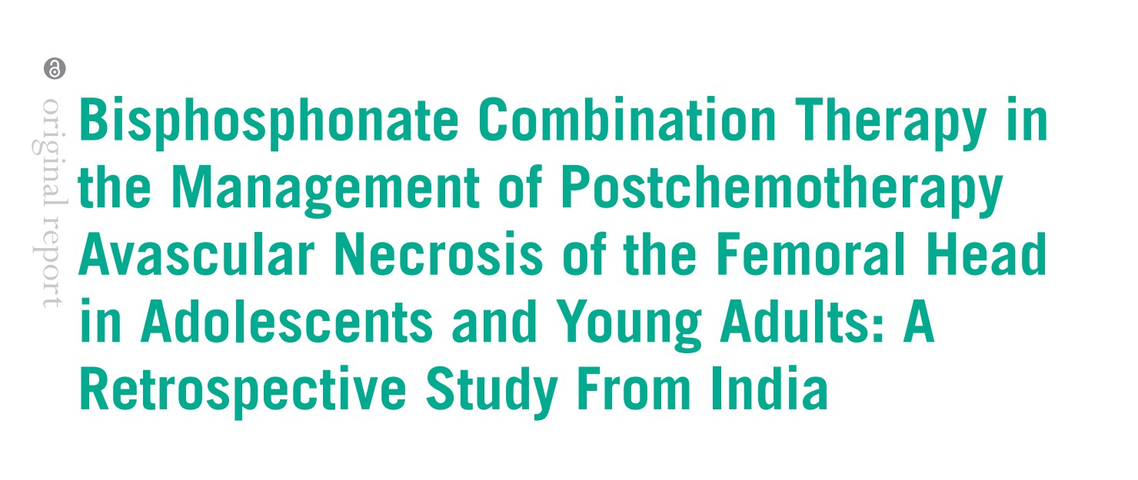

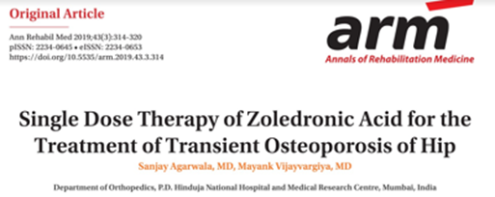

Published :AUG 2009

Slide 14
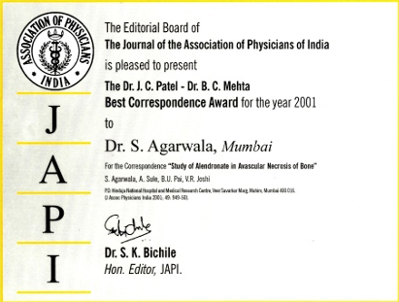
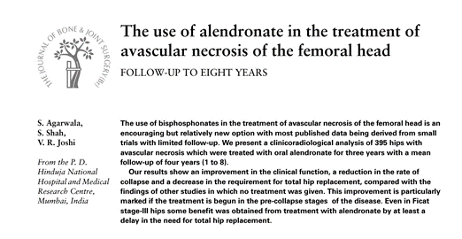
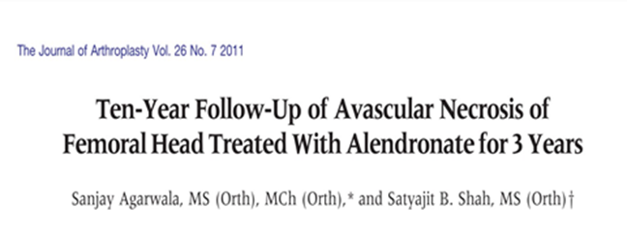
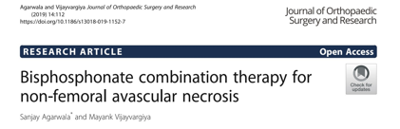
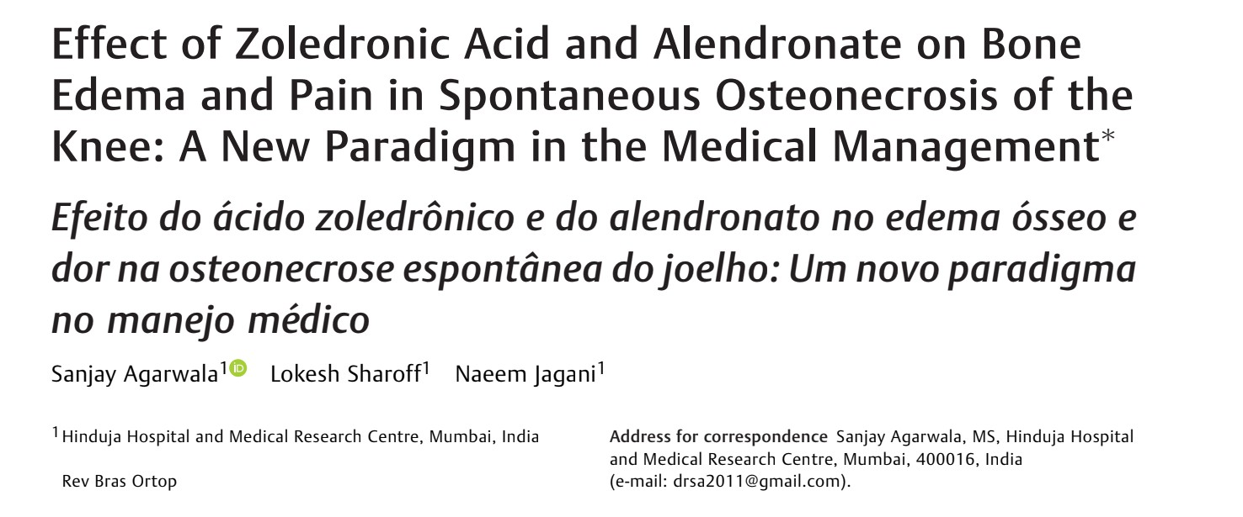
Published : 2019

Slide 15


